Slide 1
Feature Engineering Techniques
Franco Bueno Mattera
BU MET CS 677

Slide 2
Introduction
What is feature engineering?
“The process of transforming data into features that better represent the underlying problem, resulting in improved machine learning performance” Ozdemir & Susarla 201
Collecting and organizing information in order to extract any meaningful patterns that may help with the solving of a particular problem.
Objective:
Use feature feature engineering to improve overall model performance
Notes:
A definition that I like is the one shown here. In simpler terms. It just means collecting and organizing information in order to extract any meaningful pattern that may help with the solving of a problem.

Slide 3
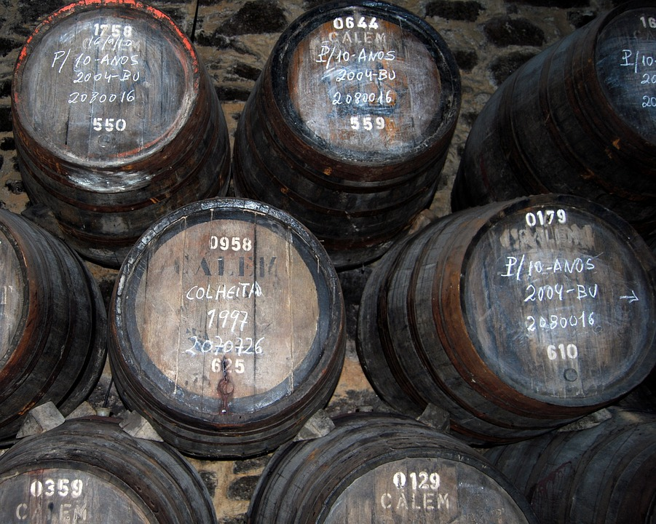

Methodology
Tested different feature engineering techniques on two datasets(classification):
Insurance dataset: High overall accuracy
Wine Dataset: Poor overall accuracy
Avoided extensive non-feature engineering improvement techniques.
Notes:
Avoided Extensive non-feature engineering improvement techniques in order to keep the effect of the techniques studies as clean as possible.
Tried different models.

Slide 4
Methodology
Techniques applied:
Scaling(when needed)
Min-Max
Standard
Resampling minority class
Random Sampling
SMOTE
ADASYN
Feature Selection
Feature importance/Shapley
Recursive Feature Elimination
Feature Construction:
Polynomial Features (2, 3 4th degree)
Feature Transformation:
PCA
LDA
Feature Learning:
Bernoulli Restricted Boltzmann Machine
Notes:
There are many different feature engineering techniques.
The techniques were cumulative.
LDA reduced the number of components even more. 15 to one for the wine dataset, from 10 to 2 for the other one.

Slide 5
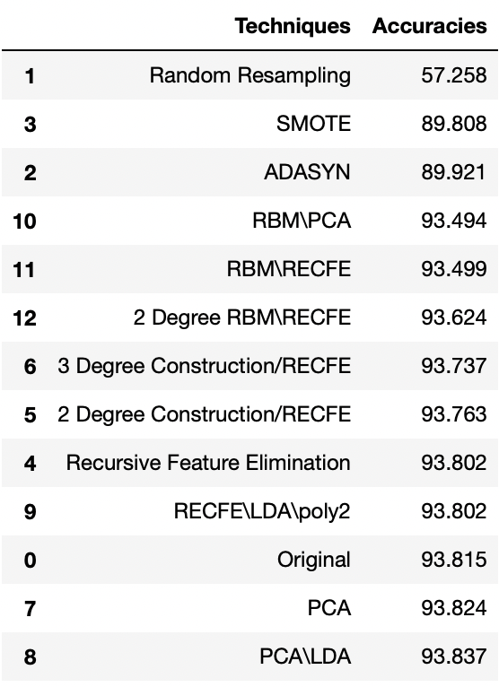
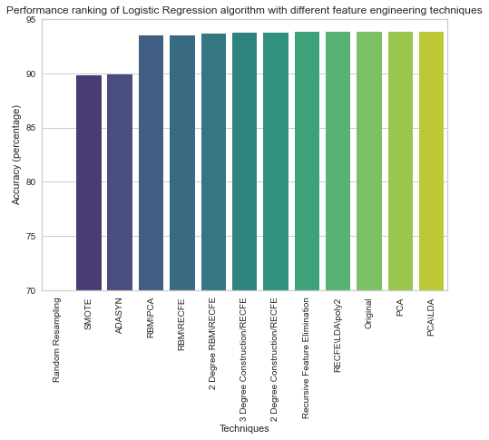
Results
Insurance Dataset (Logistic Regression)

Slide 6
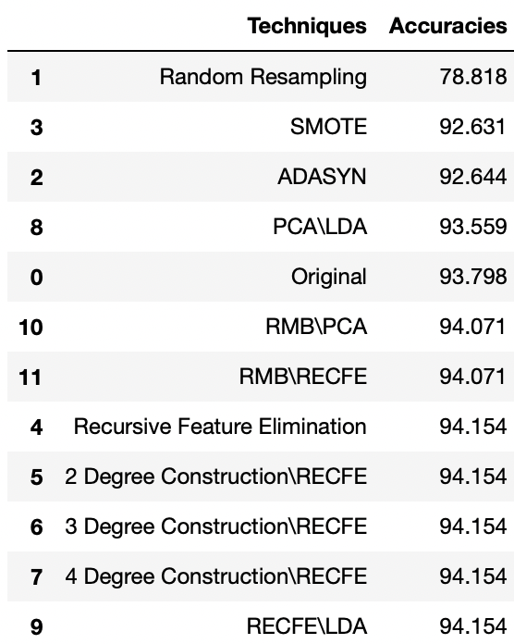
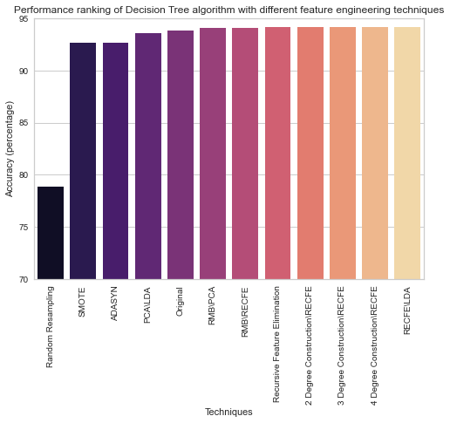
Results
Insurance Dataset (Decision Trees)

Slide 7
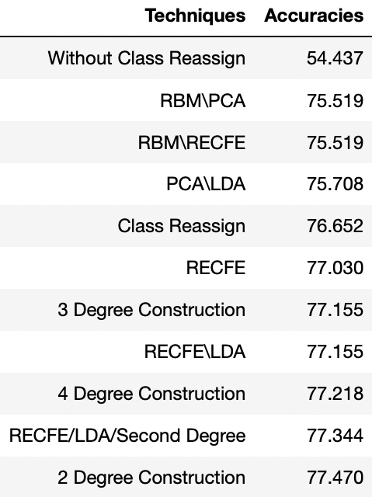
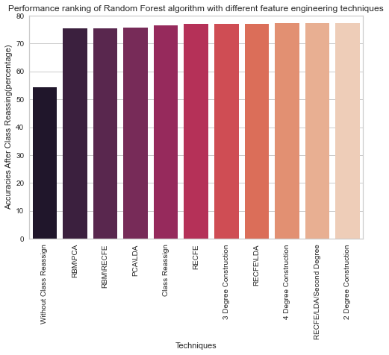
Results
Wine Dataset (Random Forest)
Notes:
Accounted for randomness by changing the random state for each technique.

Slide 8
Conclusions And Lessons Learned
Improvement in accuracy was modest.
The improvement was greater for lower initial accuracy.
Should work better in conjunction with different model improvement techniques.
Domain knowledge could play an important role in selecting or building features.
There seems to be no pattern for a right combination of techniques.
PCA, LDA and recursive feature elimination performed decent while reducing computation time.
Notes:
There seems to be no pattern for a right combination of techniques.
However, Recursive feature elimination prove to show consistent good results.

Slide 9
Thank You!

Slide 10
Consulted Sources
Sinan Ozdemir & Divya Susarla. Feature engineering made easy
https://pandas.pydata.org/pandas-docs/stable/reference/api/pandas.DataFrame.dropna.html
https://www.geeksforgeeks.org/python-pandas-isnull-and-notnull/
https://pandas.pydata.org/docs/reference/api/pandas.DataFrame.drop_duplicates.html
https://towardsdatascience.com/the-curse-of-dimensionality-50dc6e49aa1e
https://seaborn.pydata.org/examples/many_pairwise_correlations.html
https://pandas.pydata.org/docs/reference/api/pandas.DataFrame.drop.html
https://pandas.pydata.org/docs/reference/api/pandas.concat.html
https://pandas.pydata.org/docs/reference/api/pandas.get_dummies.html
https://scikit-learn.org/stable/modules/generated/sklearn.model_selection.train_test_split.html
https://www.scikit-yb.org/en/latest/api/classifier/classification_report.html
https://seaborn.pydata.org/generated/seaborn.boxplot.html https://stackoverflow.com/questions/26540035/rotate-label-text-in-seaborn-factorplot
https://pandas.pydata.org/docs/reference/api/pandas.DataFrame.boxplot.html
https://pandas.pydata.org/pandas-docs/version/0.15.0/visualization.html#visualization-box
https://matplotlib.org/3.1.1/api/pyplot_summary.html
https://www.kite.com/python/docs/numpy.around
https://imbalanced-learn.org/stable/references/generated/imblearn.over_sampling.ADASYN.html
ttps://stackoverflow.com/questions/20230326/retrieve-dataframe-of-all-but-one-specified-column
https://scikit-learn.org/stable/modules/generated/sklearn.feature_selection.RFECV.html
https://www.scikit-yb.org/en/latest/api/model_selection/importances.html
https://scikit-learn.org/stable/modules/generated/sklearn.preprocessing.PolynomialFeatures.html
https://scikit-learn.org/stable/modules/generated/sklearn.decomposition.PCA.html
https://pandas.pydata.org/docs/reference/api/pandas.DataFrame.sort_values.html
https://stackabuse.com/rotate-axis-labels-in-matplotlib/
https://stackabuse.com/how-to-set-axis-range-xlim-ylim-in-matplotlib/
https://stackoverflow.com/questions/53577630/how-to-make-pareto-chart-in-python
https://www.geeksforgeeks.org/rotate-axis-tick-labels-in-seaborn-and-matplotlib/
https://seaborn.pydata.org/generated/seaborn.barplot.html
https://seaborn.pydata.org/generated/seaborn.color_palette.html
https://www.kaggle.com/rajyellow46/wine-quality
https://www.kaggle.com/itssuru/health-insurance-premium-of-customers
https://scikit-learn.org/stable/modules/generated/sklearn.ensemble.RandomForestClassifier.html

